Slide 1
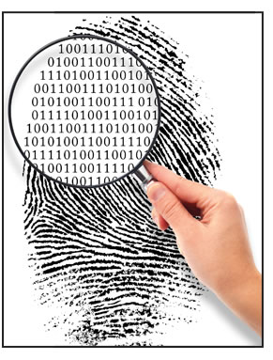
Computer Forensics
Kelsey Bretz

Slide 2
Overview
Introduction
What happens when a file is deleted
Typical Computer Forensic Investigations
Who uses Computer Forensics
Important things to remember
Options to avoid
Computer Forensic software
EnCase Forensic
How to become a Computer Forensic Examiner
Conclusion

Slide 3
What is Computer Forensics?
Collection, preservation, analysis and presentation of computer-related evidence
Determining the past actions that have taken place on a computer system using computer forensic techniques

Slide 4
What is the Purpose of Computer Forensics?
Classic Forensics
Computer forensics uses technology to search for digital evidence of a crime
Attempts to retrieve information even if it has been altered or erased so it can be used in the pursuit of an attacker or a criminal
Incident Response
Live System Analysis
Computer Forensics
Post-Mortem Analysis
Notes:
Forensics, also known as forensic science, is the application of science to questions that are of interest to the legal profession. Forensics is not limited to analyzing evidence from a murder scene; it can also be applied to technology. As computers are the foundation for communicating and recording information, a new area known as computer forensics, which uses technology to search for computer evidence of a crime, can attempt to retrieve information—even if it has been altered or erased—that can be used in the pursuit of the attacker or criminal.

Slide 5
What Happens when a File is Deleted?
Windows Operating System
File Allocation Table (FAT)
Master File Table (MFT)
FAT/MFT tells the computer where the file begins and ends
Deleted pointers to the file
FAT/MFT space occupied by the file is mark as available
The actual data that was contained in the file is not deleted
Unallocated space

Slide 6
Typical Investigations
Theft of Company Secrets (client, customer or employee lists)
Employee Sabotage
Credit Card Fraud
Financial Crimes
Embezzlement (money or information)
Economic Crimes
Harassment
Child Pornography
Major Crimes
Identity Theft

Slide 7
Media Devices that hold Potential Data
Computers and laptops
iPads
iPods
Smartphones and most other cell phones
MP3 music players
Hard Drives
Digital Cameras
USB Memory Devices
PDAs (Personal Digital Assistants)
Backup Tapes
CD-ROMs & DVD’s

Slide 8
Computer Forensic Capabilities
Recover deleted files
Find out what external devices have been attached and what users accessed them
Determine what programs ran
Recover webpages
Recover emails and users who read them
Recover chat logs
Determine file servers used
Discover document’s hidden history
Recover phone records and SMS text messages from mobile devices
Find malware and data collected

Slide 9
Who uses Computer Forensics?
Law Enforcement
Private Computer Forensic Organizations
Military
University Programs
Computer Security and IT Professionals

Slide 10
Law Enforcement
Local, State and Federal levels
Several detectives at local levels
Inadequate funding
State Police
FBI’s Computer Analysis and Response Team (CART)
Regional Computer Forensics Laboratories (RCFLs)
Philadelphia
Primarily use EnCase
Notes:
The FBI’s Computer Analysis and Response Team (C.A.R.T.) handles cases where the victim and perpetrator are in different states, which is very common with cyber crime.
In 2006 alone, CART completed more than 10,000 examinations of computer media, equating to more than one Petabyte of digital evidence. One Petabyte of information is equivalent to 250 billion pages of text; enough to fill 20 million four-drawer filing cabinets.
RCFL - They are staffed by federal, state and local law enforcement officers who passed the rigorous training to become certified as forensic examiners by the FBI’s Computer Analysis and Response Team.

Slide 11
Private Computer Forensic Organizations
Radley Forensics
Computer Forensics Associates
Bit-X-Bit
Empire Investigation LLC
Marmo Technology
Advanced Forensic Recovery of Electronic Data
Philadelphia Computer Forensics
Philadelphia Computer Forensics Analysis and Investigations
New York Computer Forensic Services
Speckin Forensic Laboratories
Notes:
Divorce cases and need proof of infidelity or cheating
Employees stealing information
White collar crime
In the private sector, computer forensic techniques and methodologies are used to investigate electronic break-ins, embezzlement, improper use of computing resources by employees, and theft of trade secrets among other things.
Those in the insurance business may use information retrieved from computer systems to identify fraud in workman's compensation, automobile or personal accident cases, or arson. I'm aware of a few cases were emails were sent outlining plans to fake back injuries and other ailments in order to receive money from insurance. These emails were used to convict those making the false claims.

Slide 12
Military
Test, identify, and gather evidence in the field
Specialized training in imaging and identifying multiple sources of electronic evidence
Analyze the evidence for rapid intelligence gathering and responding to security breach incidents
Desktop and server forensic techniques

Slide 13
University Programs
Bachelors and Masters degrees
Incident response techniques
Well funded research area
Many free sources of test images to practice on
Community colleges
Partnering with 4-year universities to complete associates and bachelors degrees
Great for working professionals
Flexible schedules and affordable tuition

Slide 14
Computer Security Professionals and IT Personnel
Network traffic
Compromised networks
Insider threats
Disloyal employees
Malware
Breach of contracts
E-mail Fraud/Spam
Theft of company documents

Slide 15
Important Factors
Legal procedures
Not compromising evidence
Treat every piece of evidence as it will be used in court
Documentation*
Chain of Custody
Write Blocks
Imaging
Bit by bit copy of a piece of electronic media (Hard drive)
Notes:
Documentation needs to be kept from beginning to end, as soon as you become involved in a case. This includes what is commonly referred to as a chain of custody form, as well as documentation pertinent to what you do during your analysis. We cannot overemphasize the importance of documentation. When involved in a situation where you are conducting a computer forensics analysis, we recommend that you establish and keep the mindset that the case or situation is going to end up in court. This will go a long way in helping you to make sure that you are keeping the appropriate documentation. Take for granted that you will be questioned on every aspect of the case, and everything that you do.

Slide 16
What Should be Avoided During an Investigation?
Changing data
Changing time or date stamps
Changing files
Overwriting unallocated disk space
This can happen when re-booting
Verify Hash values from images

Slide 17
Computer Forensic Tools
Parse through the created image
Built in system parser
Rebuilds both active and deleted files
Open source
Commercial sources

Slide 18
Common Computer Forensic Software
ArcSight Logger
Netwitness Investigator
Quest Change Auditor
Cellebrite
Physical Analyzer
Lantern
Access Data’s Forensic Toolkit (FTK)
EnCase Cybersecurity
EnCase eDiscovery
EnCase Portable
EnCase Forensic*
Notes:
arcSight logger Automate analysis, alerting, reporting, intelligence of logs and events for IT security, IT operations, IT GRC and log analytics
NetWitness Investigator – anaylize network traffic – mainly used by IT professionals but now law enforcement and other public and private firms use it- download off the internet, not sure how reliable it is
Quest ChangeAuditor – report and analyze what is happening on the network. Translate raw data into user friendly data
Encase and the forensic tool kit are both accepted in court and mainly used by law enforcement and government agencies.
FTK is database driven so wont lose work if your computer crashes
Both have a user friendly interface and can do many of the same things but encase is what most law enforcement agencies choose to use so that is what I will talk about in the rest of the presentation.

Slide 19
EnCase Forensic
Acquisition
Reporting
EnScript :
Scripting facility
Various API's for interacting with evidence
Collect, Analyze and examine data
Deleted files
Unallocated space
File slack
Duplicates of original data (Imaging)
Accuracy can be verified by hash and Cyclic Redundancy Check values

Slide 20
EnCase Forensic
Many operating systems
Windows
Linux
Apple iOS
Sun/Oracle Solaris
Supported smartphones
Recommended to run on Window 7 (64 bit) operating system

Slide 21
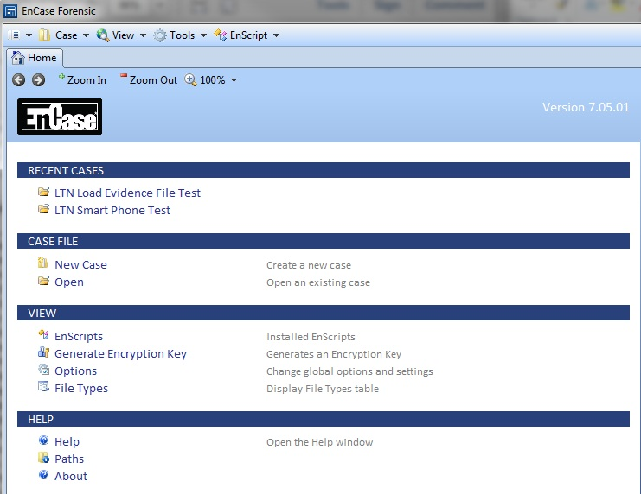
EnCase Forensic

Slide 22
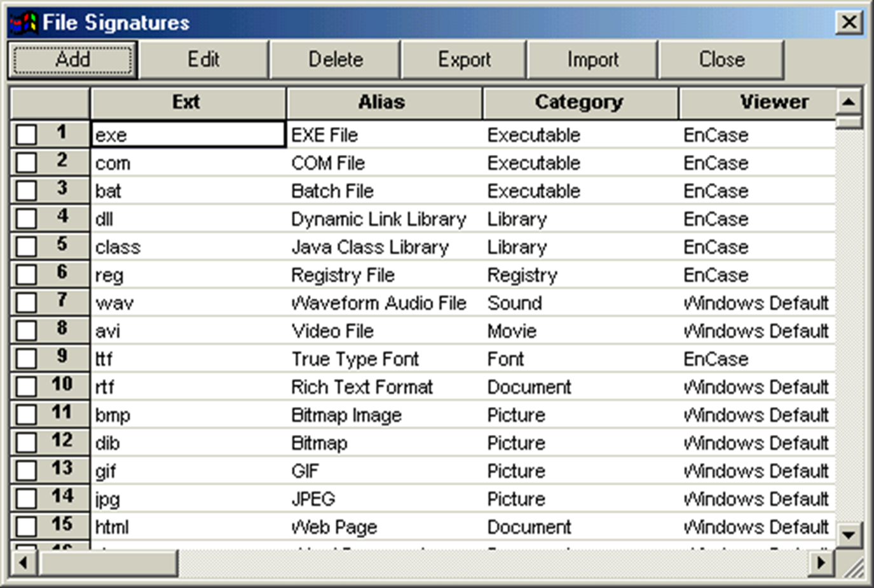
File Signatures

Slide 23
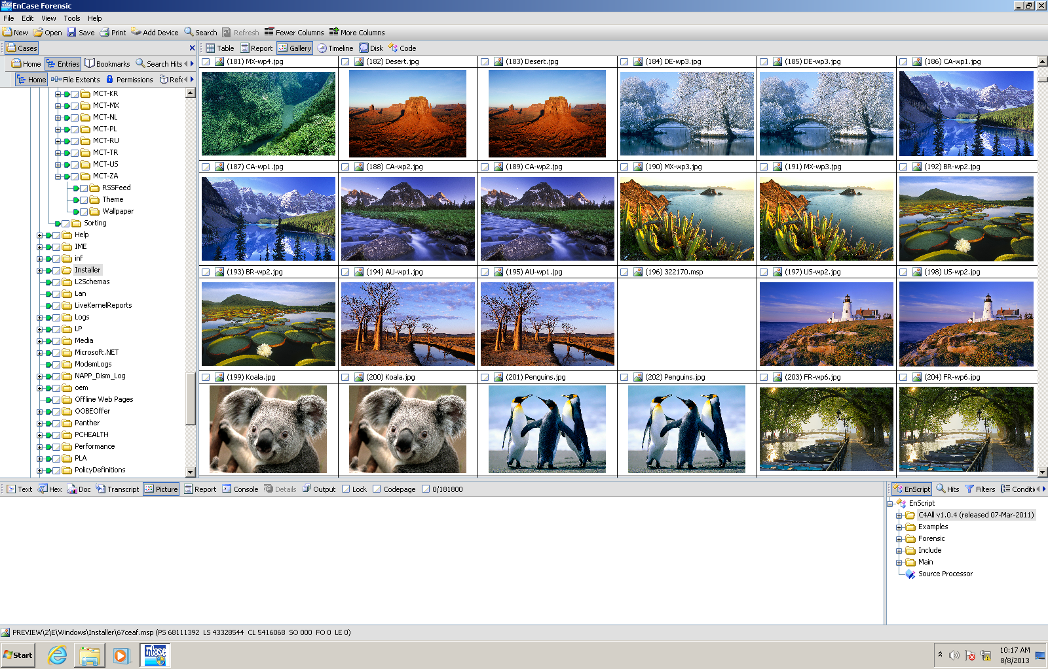
EnCase Gallery
Notes:
Gallery viewer

Slide 24
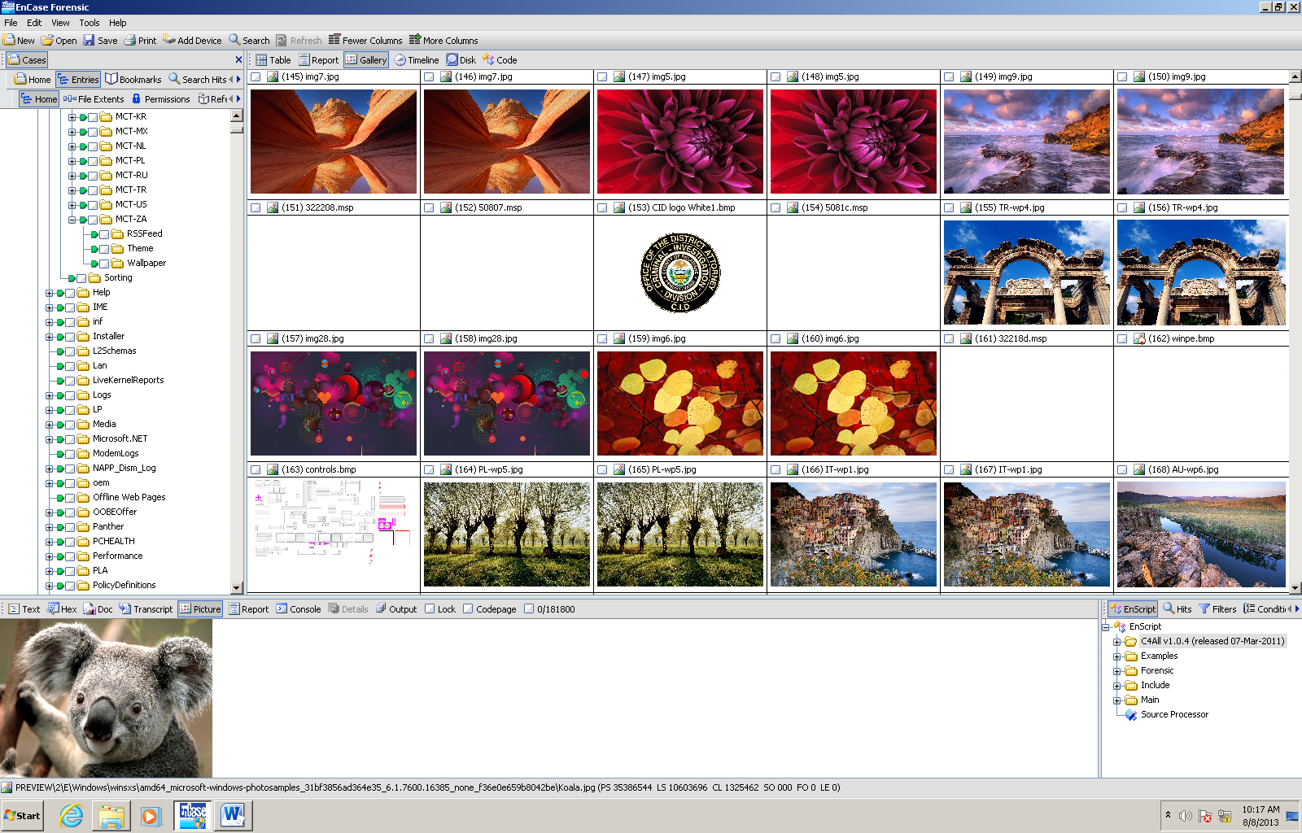
EnCase Gallery

Slide 25
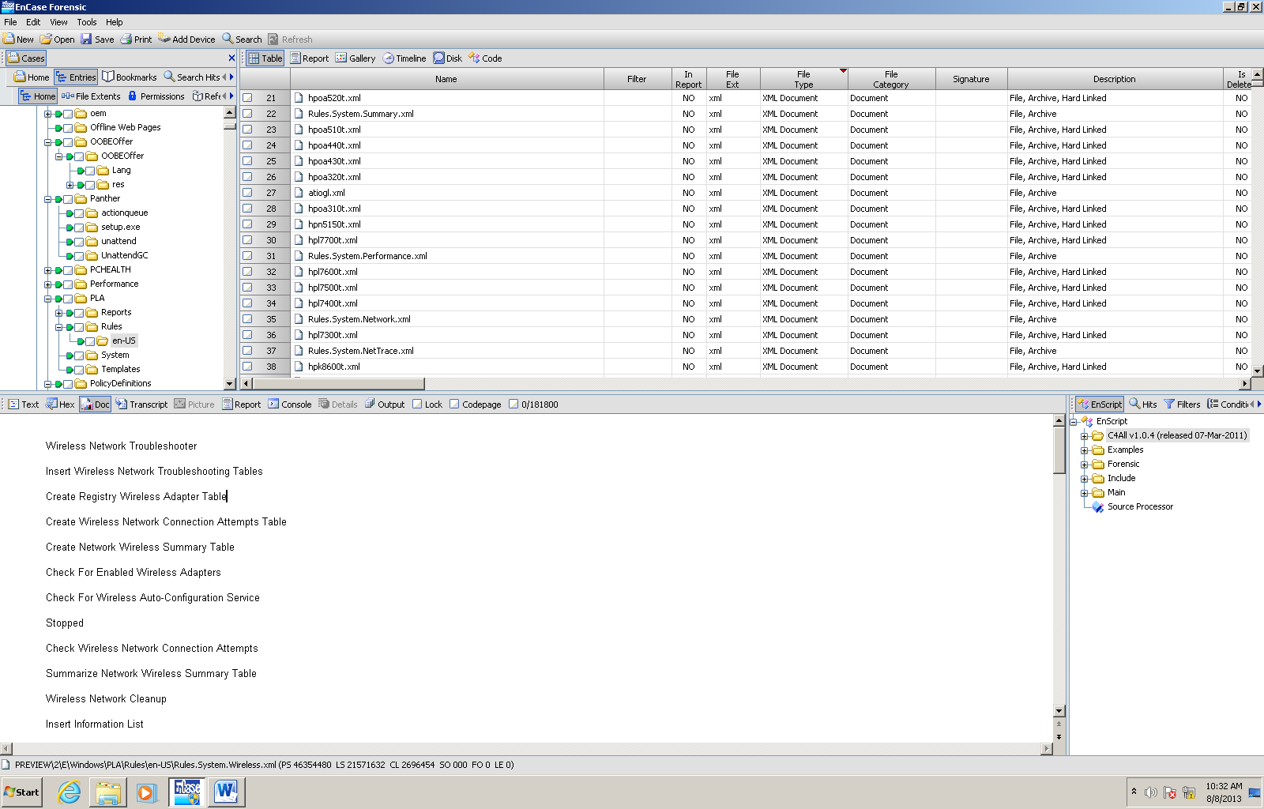
EnCase Document View

Slide 26
Perform a Search
Raw Search
A search based on keywords that search the entire drive for a match
Slow process on larger drives
Indexed Search
A search that requires the drive to be indexed
Indexing can take a long time
Searches are instantaneous

Slide 27
Bookmark Specific Evidence
Bookmark Findings
Raw Text Bookmarks
Data Structure Bookmarks
Notable File Bookmarks
Multiple Notable File Bookmarks
Note Bookmarks
Table Bookmarks
Transcript Bookmarks

Slide 28
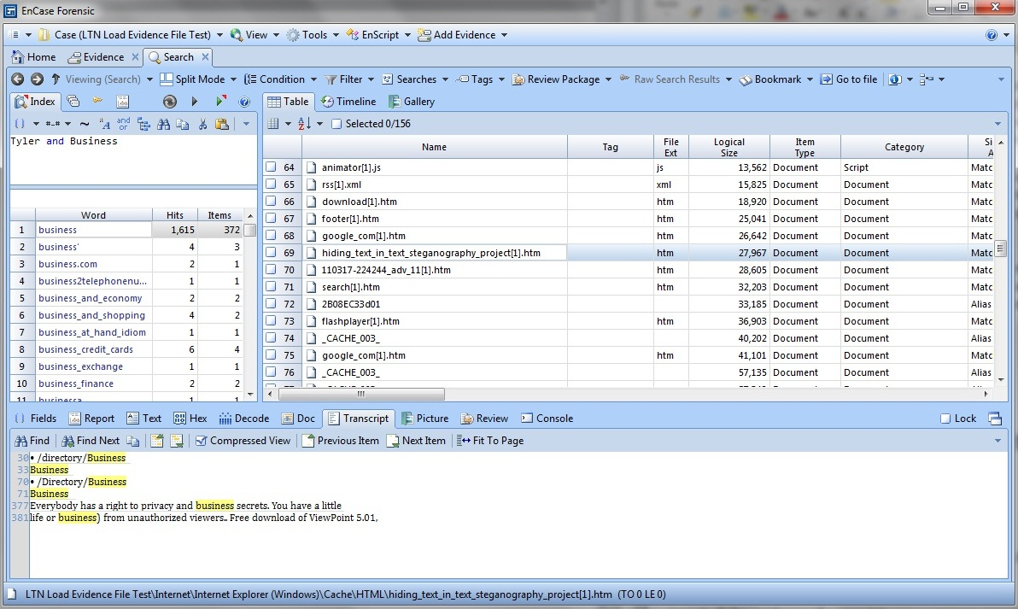
Indexed Search

Slide 29
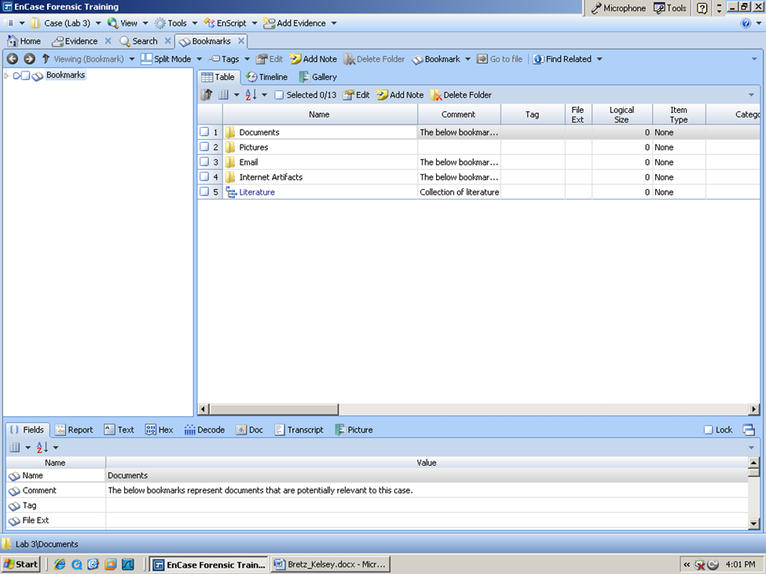
Bookmark Screen

Slide 30
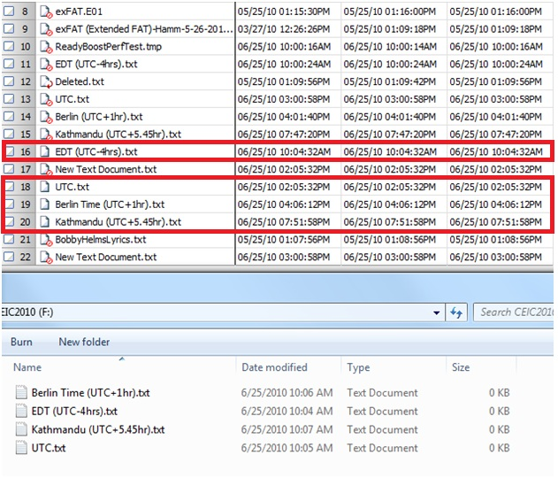
Deleted Files

Slide 31
How to get Started
Step 1: Obtain a degree
Today a bachelors degree is favored
FBI prefers a different scholarly degree over computer forensics
Step 2: Get Certified
EnCase Certified Examiner (EnCE)
Computer Forensics Examiner (CCFE)
Certified Computer Examiner (CCE)
Some states require a Private Investigator License
Step 3: Find a Job
Law Enforcement (Local, State, Federal)
Homeland Security offices, the NSA and the FBI have a growing need for examiners
Military
Private Firms
IT/Security Professions

Slide 32
http://www.youtube.com/watch?v=vJdME6vczeo

Slide 33
Conclusion
Computer Forensics helps determine the WHO, WHAT, WHEN, and WHERE related to a computer-based crime or violation.
Who uses Computer Forensics
Situations to use Computer Forensics
Computer Forensic Software
Do and Don’ts of practicing Computer Forensics
How to get involved in Computer Forensics

Slide 34
References
http://www.computer-forensics.net/
http://www.scmagazine.com/best-computer-forensics-tool/article/195999/
http://www.law.com/jsp/lawtechnologynews/PubArticleLTN.jsp?id=1202584495563&Product_Review_Encase_Forensic_7&slreturn=20130405160529
https://www.ncjrs.gov/pdffiles1/nij/183451.pdf
http://www.westwood.edu/programs/school-of-technology/computer-forensics-online-degree/law-enforcement-computer-forensics
Computer Forensics: Info Sec Pro Guide
Security Guide to Network Security Fundamentals

Slide 35
Questions?

